Slide 1
Lecture n : Requirement Modelling
CSE314-Software Engineering Practices
Unit-II
Topic: Class Based Modelling
Presented By Dr. R. Kavitha,
CSE,SoC, SASTRA University.
Text Book: “Software Engineering – A practitioner approach”
By Roger Pressman, 8th edition, 2015.
1

Slide 2
Unit-II
Requirement Modeling:
Class Base Modeling

Slide 3
Elements of Class Based Modeling
Objects
Relationships
Association
(1…n)
Cardinality
( 0 / 1)
Classes
(BCE)
Attributes,
Data types
Methods/
Functions/
Services,
Access specification
CRC
Models
Class
Responsibilities
Collaborators
(Hierarchical relationships)

Slide 4
Identifying Analysis Classes
A analysis class identified by a Noun or Noun Phrase, synonyms.
Problem space ? Noun used in description
Solution space ? Noun used in implementation

Slide 5
Identifying class names
How to identify a class name?
Entities Names : Actor, person, special requirement…camera, sensor, printer, plotter
Occurences / Event Names : Robotic Movements
Structure : File structure, Block_chain, Four-wheeled vehicles
Place : NorthZone, SouthZone, office, hospital
Things: Living, Non-living, reports, signals, table
Organization Unit : Department or Division name

Slide 6
Budds taxonomy of classes
Smart class, dummy class, helper class, Manager class(controller), data, view or observer classes (snapshot), data managers (admin/server),

Slide 7
Identify proper class names
Images
Image_Inversion()
Invert_image()
Install_app()
Safe_home_app
Cameras – orientation_Type, direction_Axis
Pixels – color, Type , size
Login()
Login_window
View()
ViewButton
Show()
MenuCards
Tickets

Slide 8
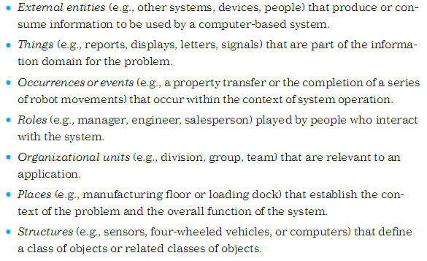
Analysis Classes Guidelines

Slide 9
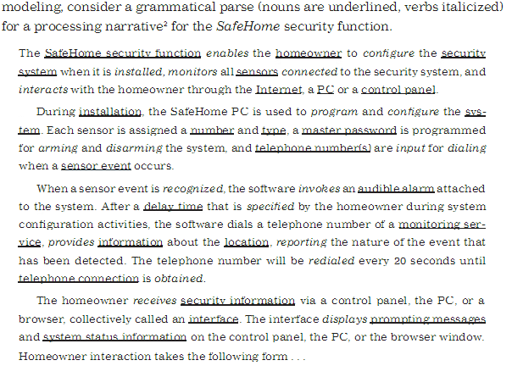
Identified class nouns in safe-home-surveillance application

Slide 10
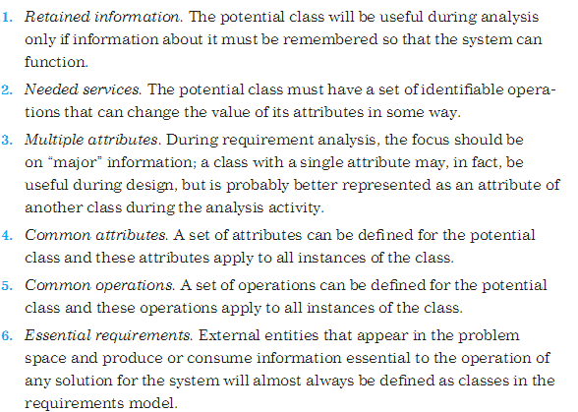
Coad and Yourdon suggests six characteristics of potential classes inclusion of analysis

Slide 11
THANK YOU

